Slide 1
Coding Simple Linear Regression From Scratch

Slide 2


Join at slido.com #3089162
ⓘ Start presenting to display the joining instructions on this slide.

Slide 3
Libraries we will use
A library in coding is a collection of pre-written code modules and functions that provide specific functionality to facilitate programming tasks.
Includes a wide range of tools and utilities designed to simplify common tasks, enhance performance, and promote code reuse.
Libraries serve as ready-made resources that programmers can leverage to expedite development and solve problems efficiently within their chosen programming language or environment.
Using libraries avoids writing already existing functions from scratch everytime and so saves time. Instead of multiple lines of code yourself, you can accomplish the same thing by writing one line of code that behind the scenes does the exact same thing. – Someone else has already written the multiple lines of code for you so you don’t have to do the same thing.
We shall be using the numpy, matplotlib and pandas libraries to help us write simple linear regression from scratch.

Slide 4
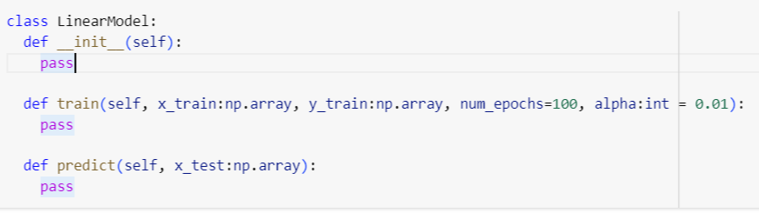
Skeleton Code

Slide 5
Useful numpy info
np.sum is a useful function that you may want to use
np.array is a useful function that you may want to use
Try and figure out how numpy handles multiplication of arrays with numbers.
Learn more using the numpy documentation and api reference!

Slide 6
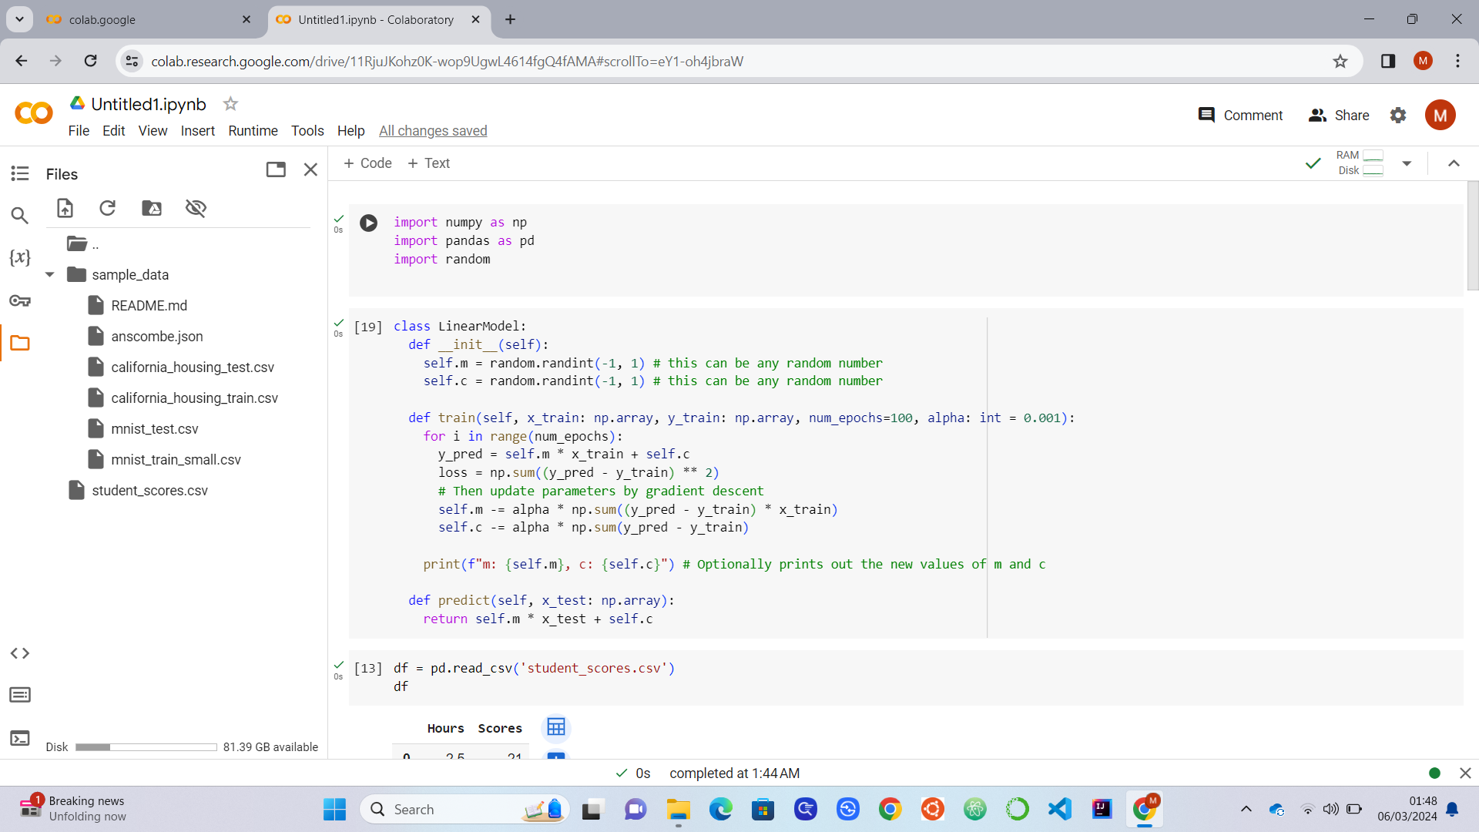
First step, do your imports

Slide 7
The __init__ function

Slide 8
The train function

Slide 9
The predict function (used in testing)

Slide 10
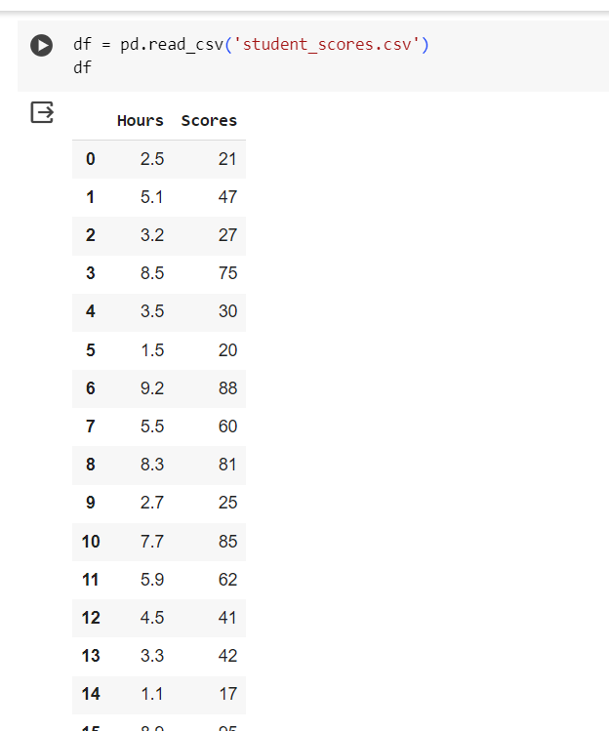
Now we get our dataset ready…

Slide 11
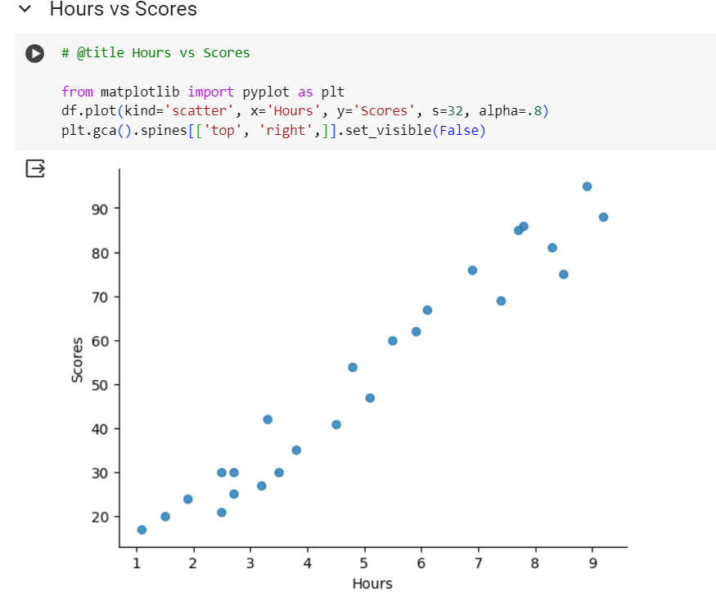
Plot a graph to visualise the dataset..

Slide 12
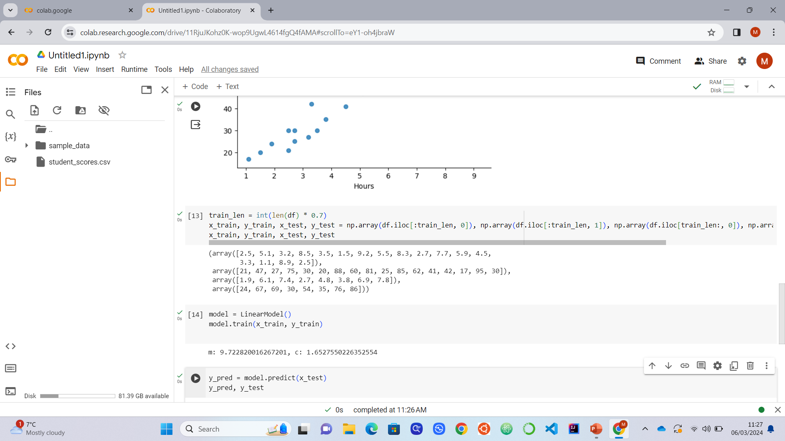
Split the dataset into training and test sets

Slide 13
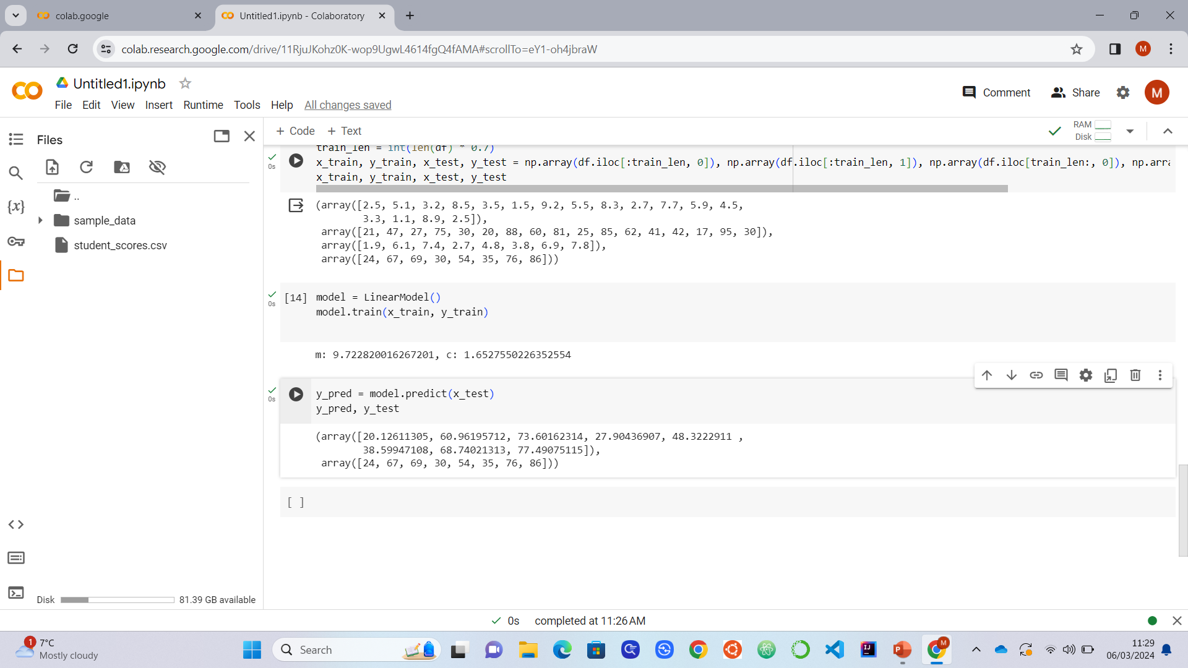
Create an instance of the model, train it, test it

Slide 14
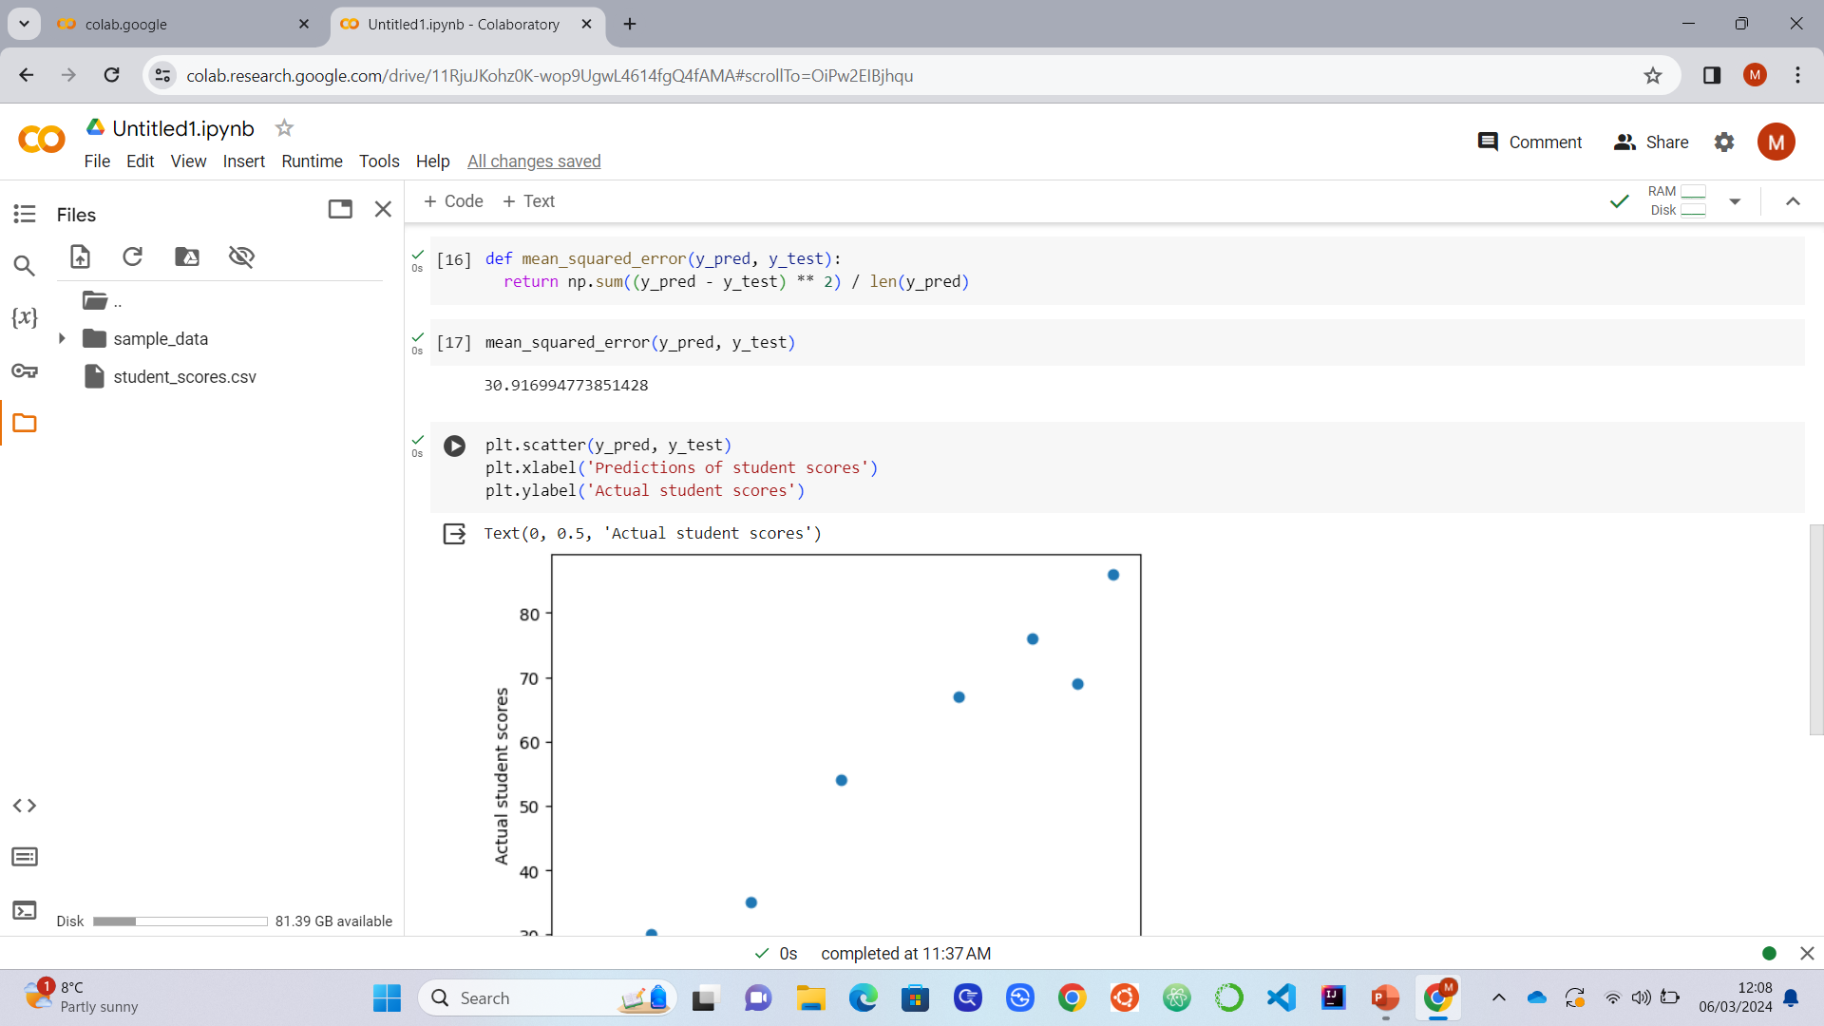
Create Mean Squared Error function and evaluate predictions

Slide 15
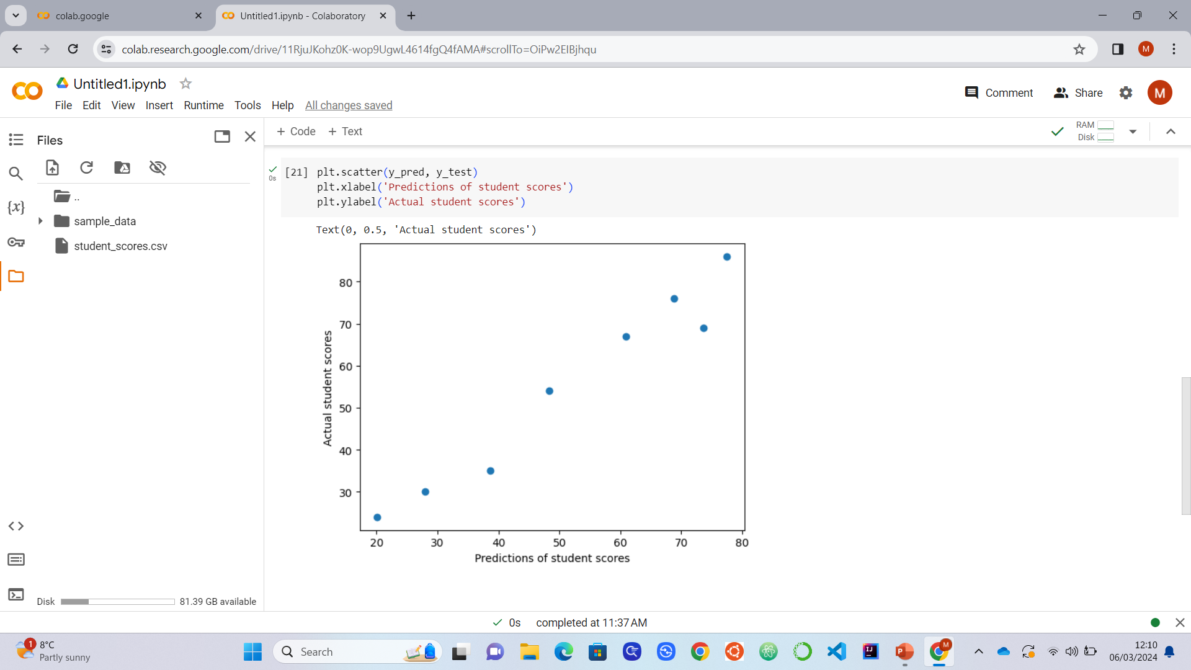
Visualise predictions

Slide 16
Feedback Please ☺
https://forms.office.com/e/qfQFycEZBm

